Slide 1

Shell Bootcamp 2024 3 Reflections for Week 2
Gayathri Mohandas
Date : 06-Sept-2024

Slide 2

About Me
We all are on our own journey, at our own pace.

Slide 3

My learnings from this week!

Slide 4

Learning 1 | My takeaways
Unit Testing
Purpose: Tests individual components or functions.
Focus: Ensures each part works correctly in isolation.
Integration Testing
Purpose: Tests interactions between integrated units or modules.
Focus: Identifies issues in interfaces and interactions.
System Testing
Purpose: Tests the complete and integrated application.
Focus: Verifies the system meets specified requirements.

Slide 5
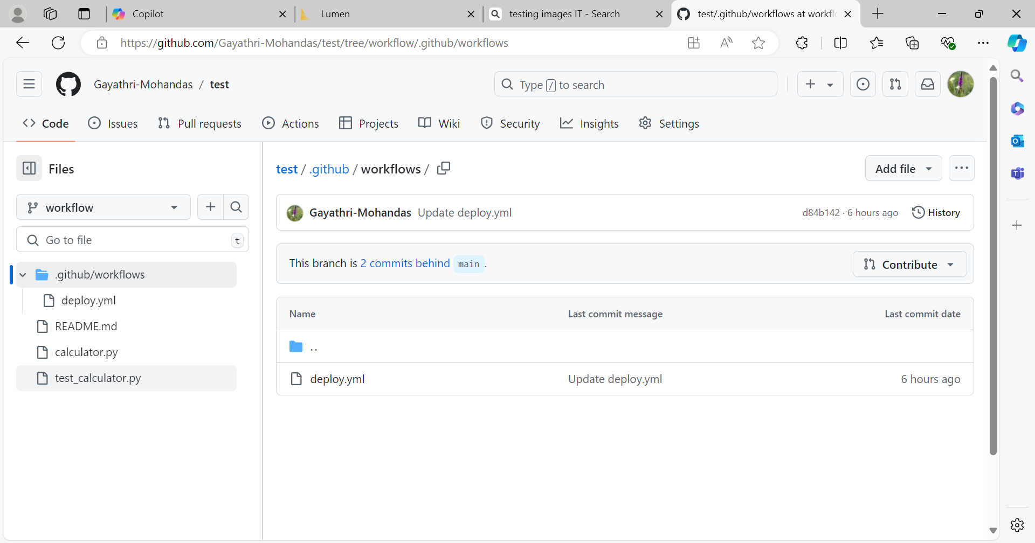
Learning 2 | My takeaways
CI/CD in GitHub workflows automates the software development process, ensuring faster and more reliable code deployments. It helps catch bugs early through continuous integration and testing, improving code quality. Continuous delivery/deployment ensures that updates are consistently and safely released to production. This leads to more efficient development cycles and higher-quality software.

Slide 6

Learning 3 | My takeaways
The cloud provides scalable and flexible resources, allowing businesses to adjust their computing power based on demand. It enhances collaboration by enabling access to data and applications from anywhere, at any time. Cloud services also offer cost savings by reducing the need for physical infrastructure and maintenance. Additionally, it ensures data security and disaster recovery through robust backup and recovery solutions.
Iaas, Paas, Saas

Slide 7

Relevance of learnings for my organization

Slide 8
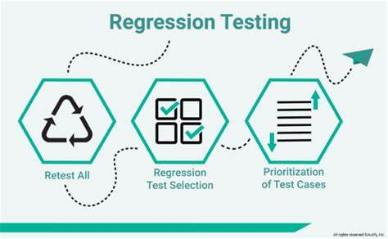
Learning 1 | Relevance for Shell
How I feel Shell implements this learning
Unit testing performed on individual components. Followed by integration testing and even system testing.
Adding on regular smoke tests and regression tests when new codes modified.
How I feel Shell benefits from this learning
Ensures the units and modules are up
Exhaustive tests when new codes are introduced ensures the safety of system

Slide 9
Learning 2 | Relevance for Shell
How I feel Shell implements this learning
Improved Efficiency: Streamlines and automates repeatable tasks, reducing errors and saving time1.
Enhanced Collaboration: Provides better visibility into tasks, enabling team members to work together more effectively2.
How I feel Shell benefits from this learning
Cost savings
Increased Transparency

Slide 10
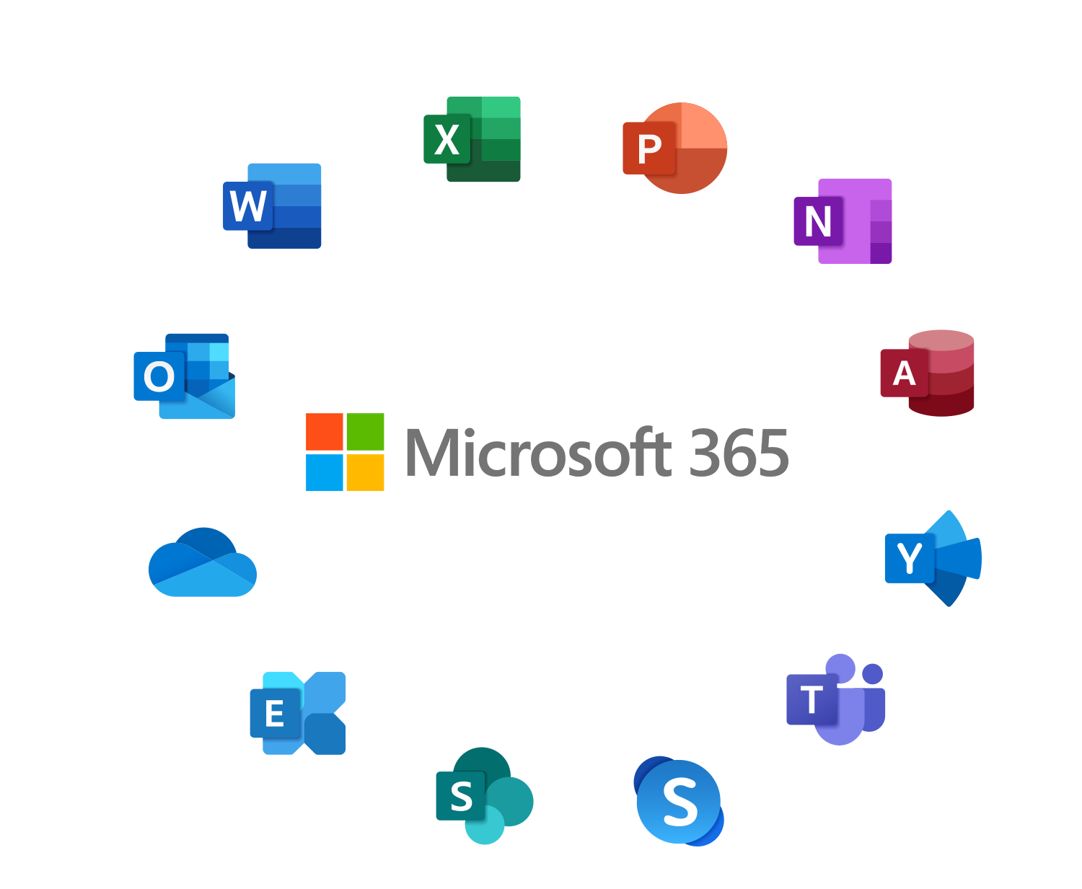
Learning 3 | Relevance for Shell
How I feel Shell implements this learn
Saas - Google Workspace, Salesforce, Microsoft 365.
Paas – Microsoft Azure App Services.
Iaas - Amazon Web Services (AWS), Microsoft Azure, Google Cloud Platform (GCP)
How I feel Shell benefits from this learning
Scalability
Elasticity
On demand

Slide 11

Challenges in implementing learning

Slide 12
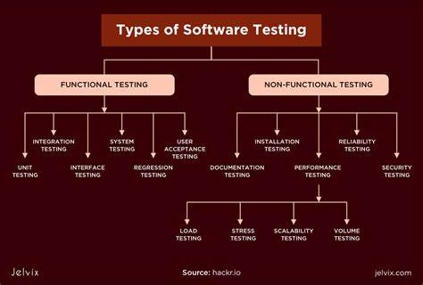
Challenge faced while implementing Learning 1
What were the challenges I faced while implementing Learning 1 and my plan to overcome them
Understanding different testing scenarios
https://github.com/Gayathri-Mohandas/UNext-Bootcamp

Slide 13
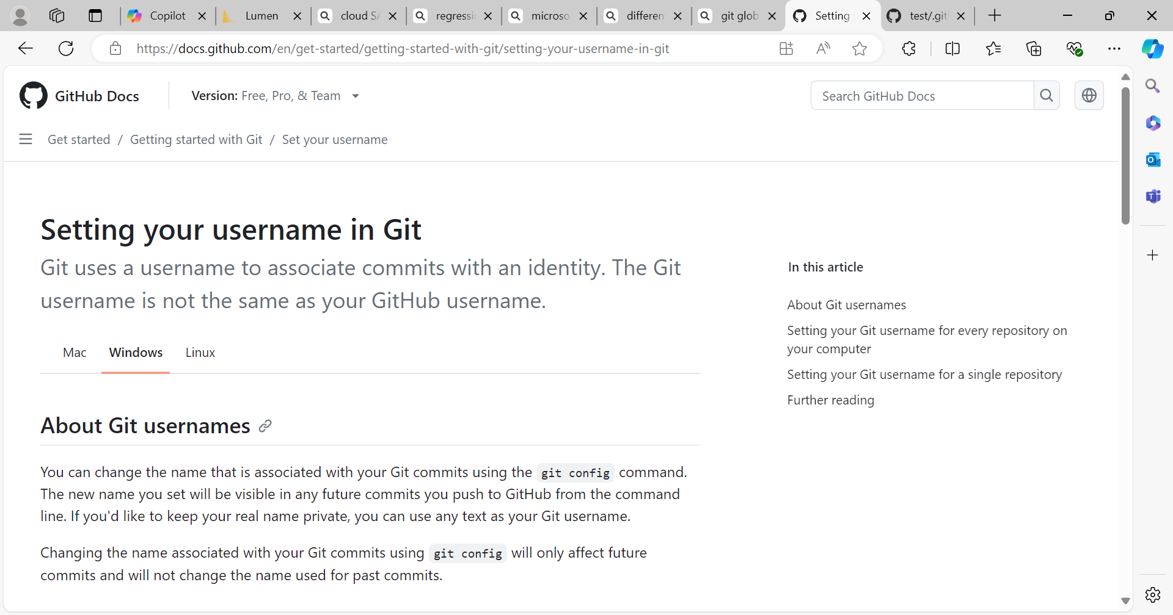
Challenge faced while implementing Learning 2
What were the challenges I faced while implementing Learning 2 and my plan to overcome them
Clone a repo
Resolved via github username and email command
https://github.com/Gayathri-Mohandas/UNext-Bootcamp

Slide 14
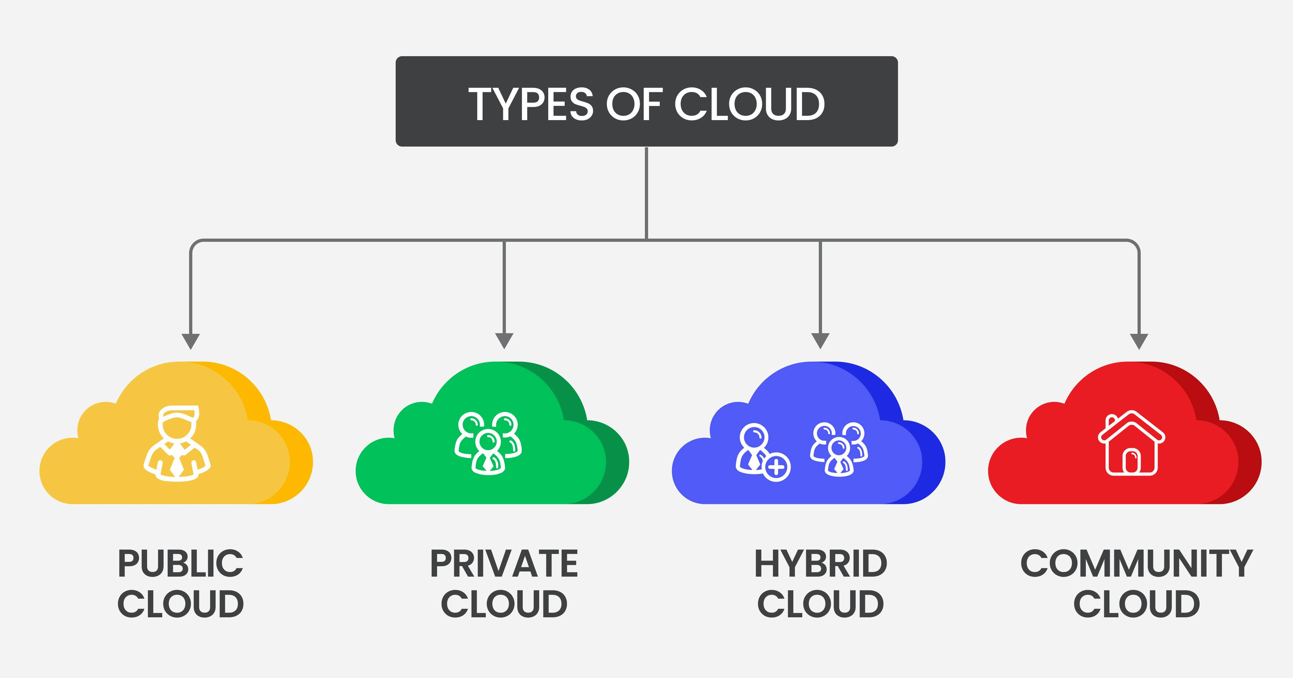
Challenge faced while implementing Learning 3
What were the challenges I faced while implementing Learning 3 and my plan to overcome them
Scenarios and examples of cloud
https://github.com/Gayathri-Mohandas/UNext-Bootcamp

Slide 15

Action Plan

Slide 16
My Action Plan for this Week
Actions
Timeline
Status
1. Github workflows
2. Azure devOps Agile
YouTube lectures
Watch more YouTube tutorials
done
In progress

Slide 17

Learning is also Fun!

Slide 18
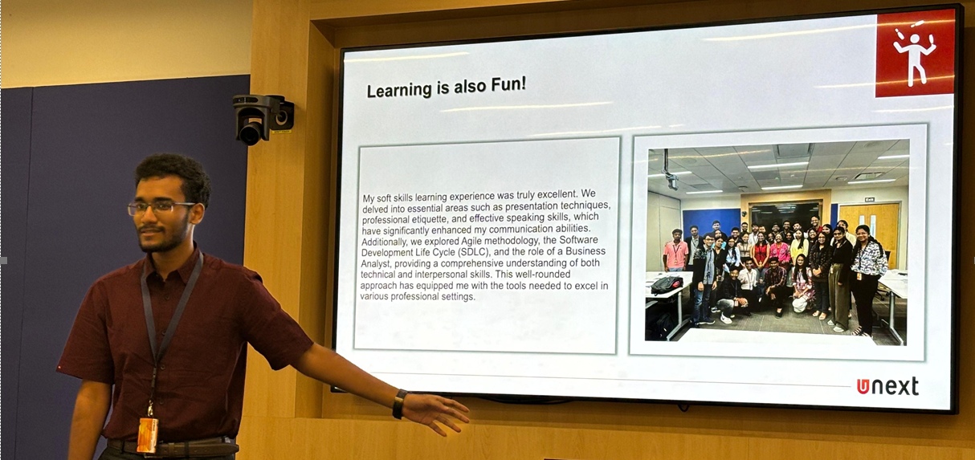
Learning is also Fun!
Please share how ”Your” learning was fun this week
JAM sessions
Hands on implementation of Vm

Slide 19

Summary
DBMS, Software testing, Devops, Cloud, Case work
Hands on sessions of Vm, Agile, workflows, github actions

Slide 20
Thank You

